Slide 1
Clusters Random Constant
How to Report?
The logic for oclcusion – visible doesn‘t work

Slide 2
Description of presentation
Plotting each cluster in a separate sequence of 9 Topoplots, mostly for overview.
Time interval is from first significant cluster moment to the last, bins are equally spaced from cluster onset to cluster offset
Going from smallest cluster to largest cluster each for positive and negative

Slide 3
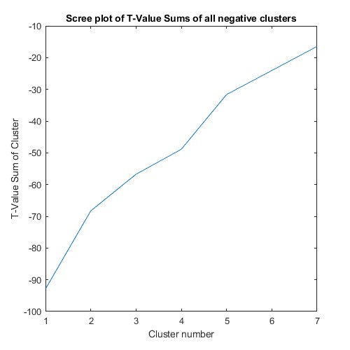
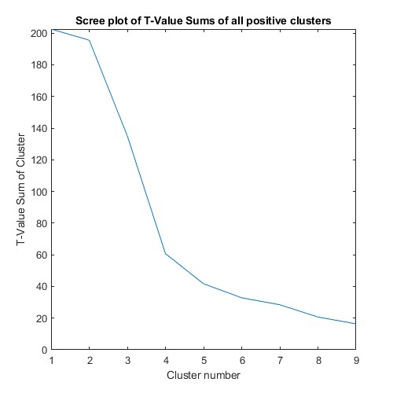
Scree Plots

Slide 4
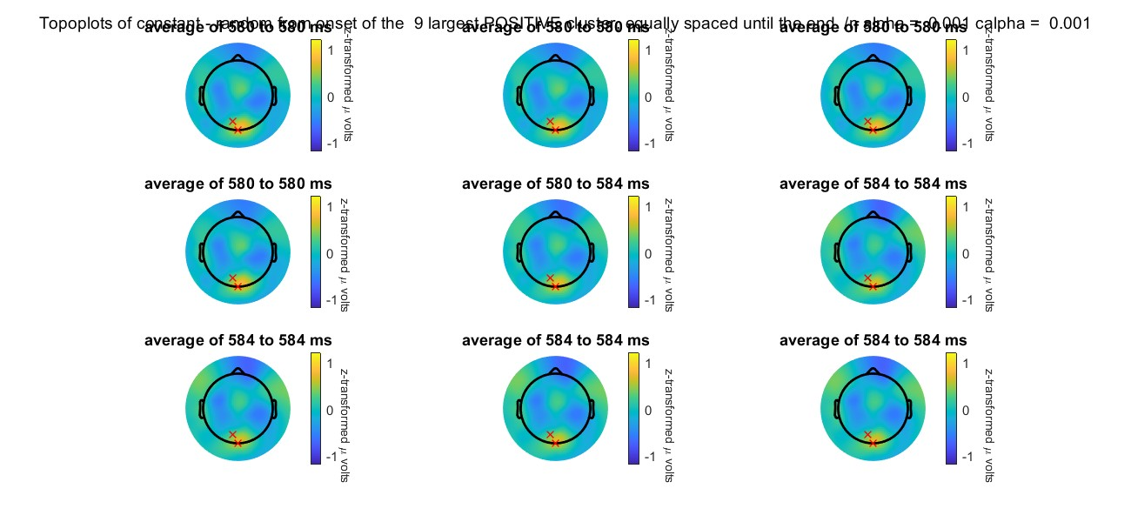
Topoplots Positive

Slide 5
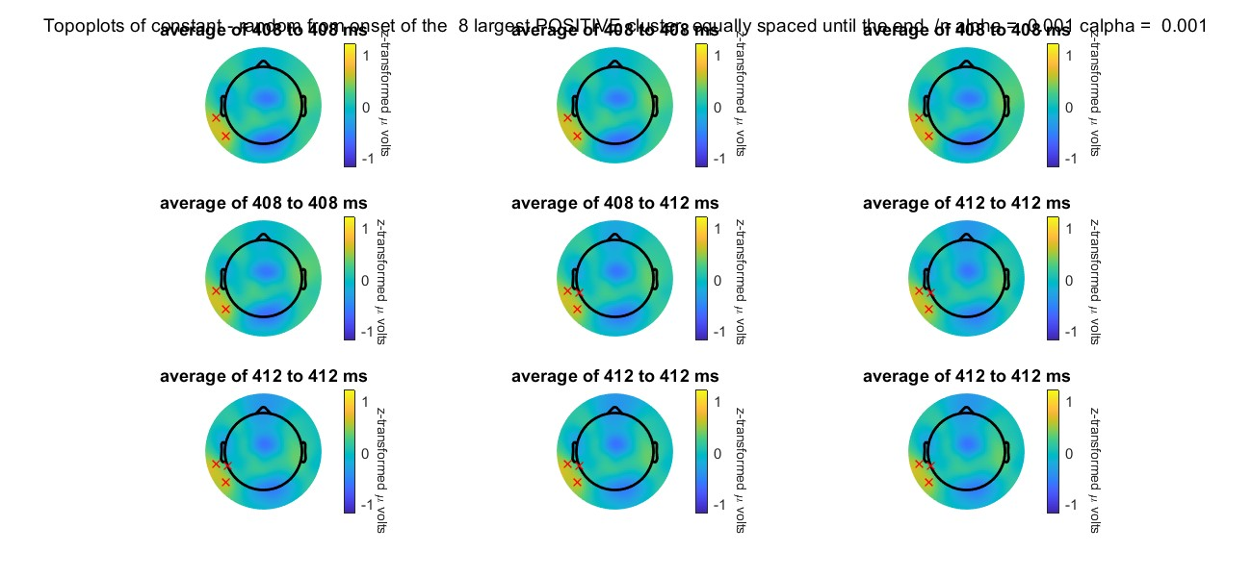
Topoplots Positive

Slide 6
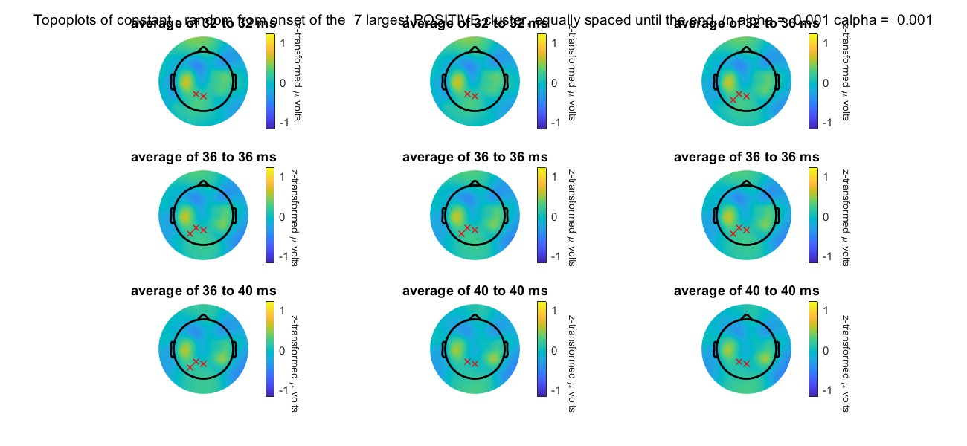
Topoplots Positive

Slide 7
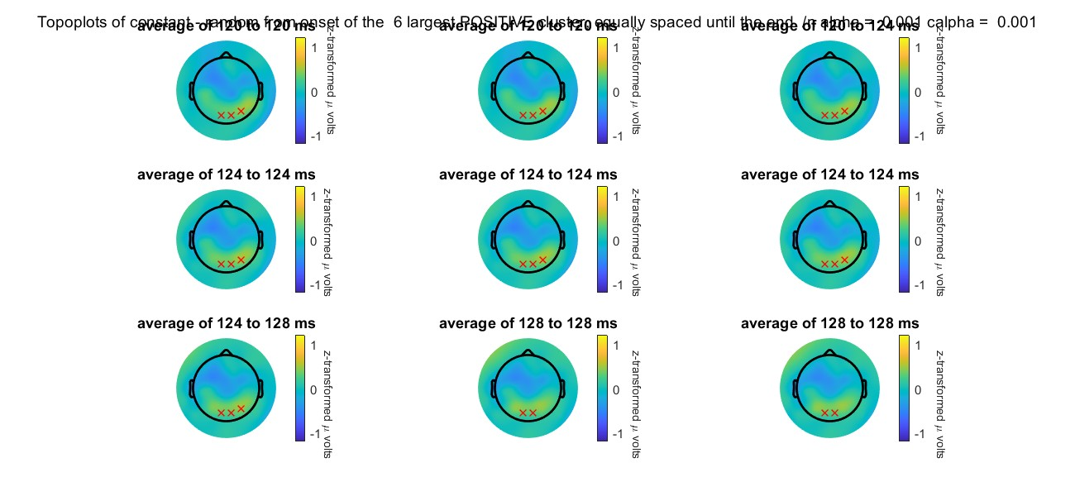
Topoplots Positive

Slide 8
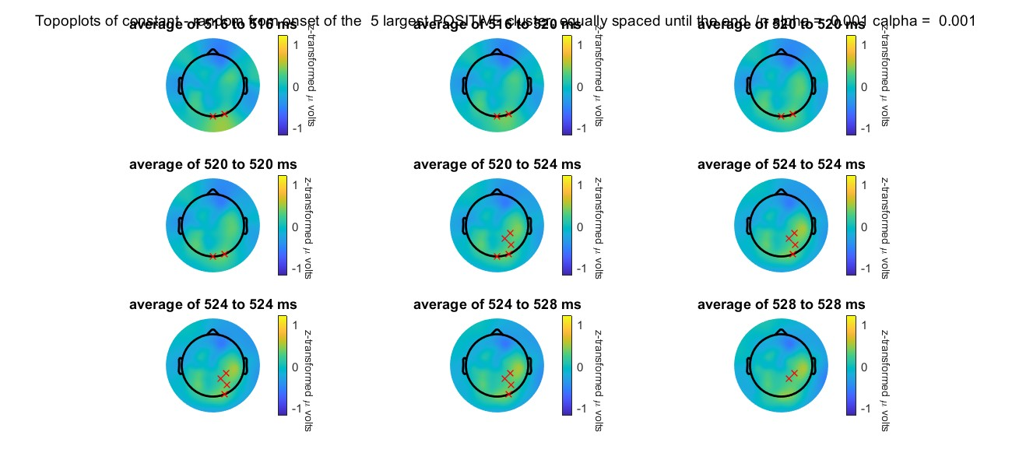
Topoplots Positive

Slide 9
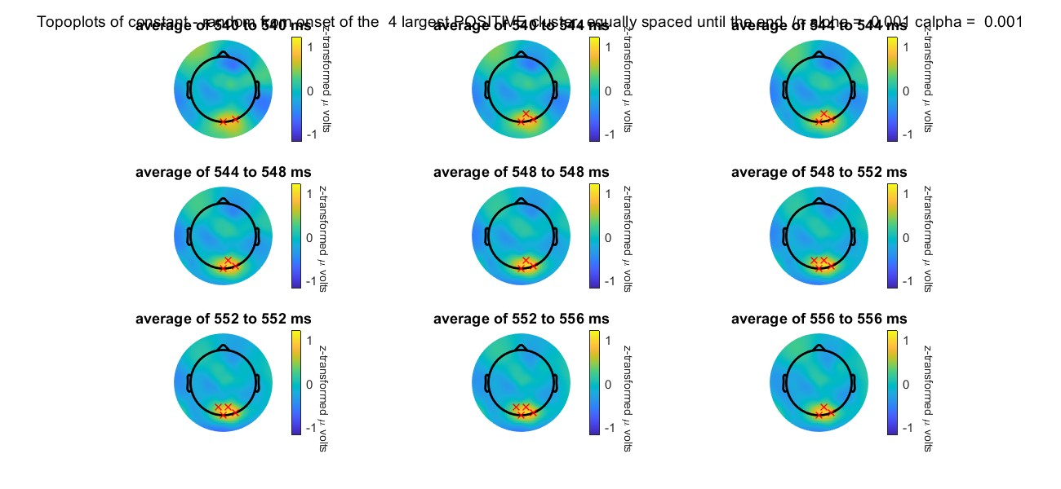
Topoplots Positive

Slide 10
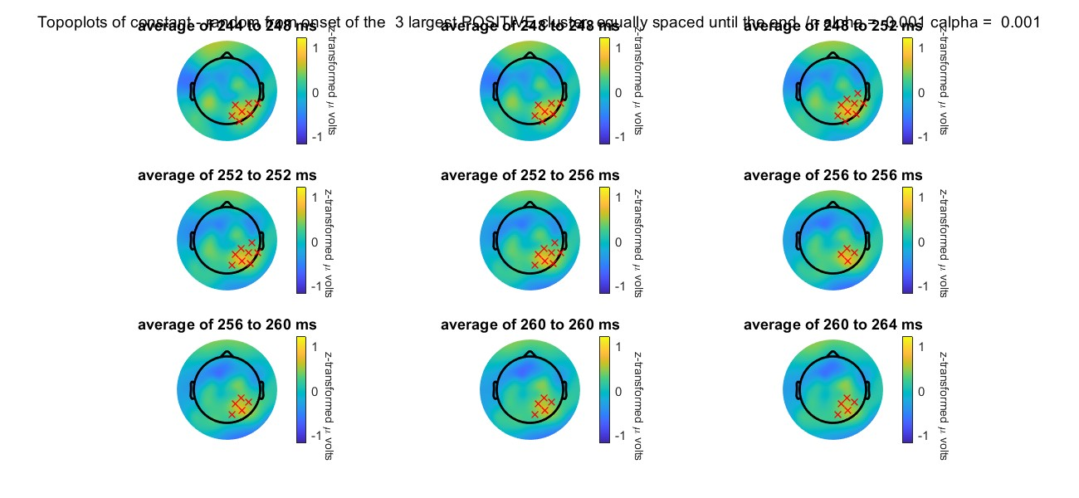
Topoplots Positive

Slide 11
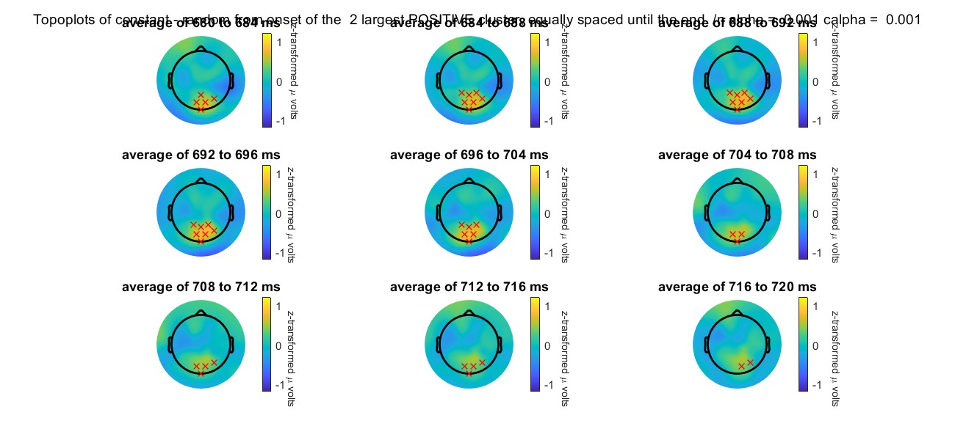
Topoplots Positive

Slide 12
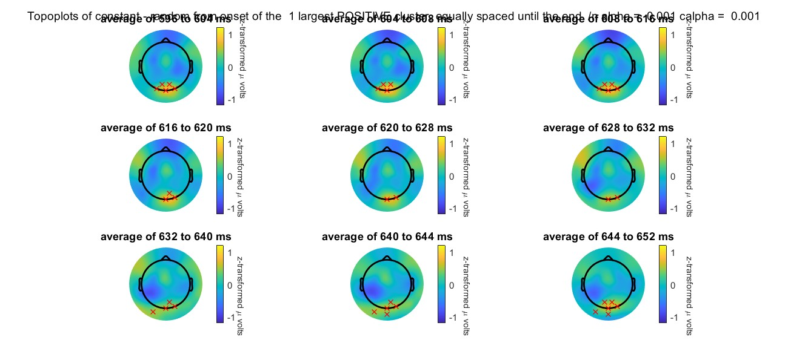
Topoplots Positive: Largest Cluster has 27.6 % of t-values

Slide 13
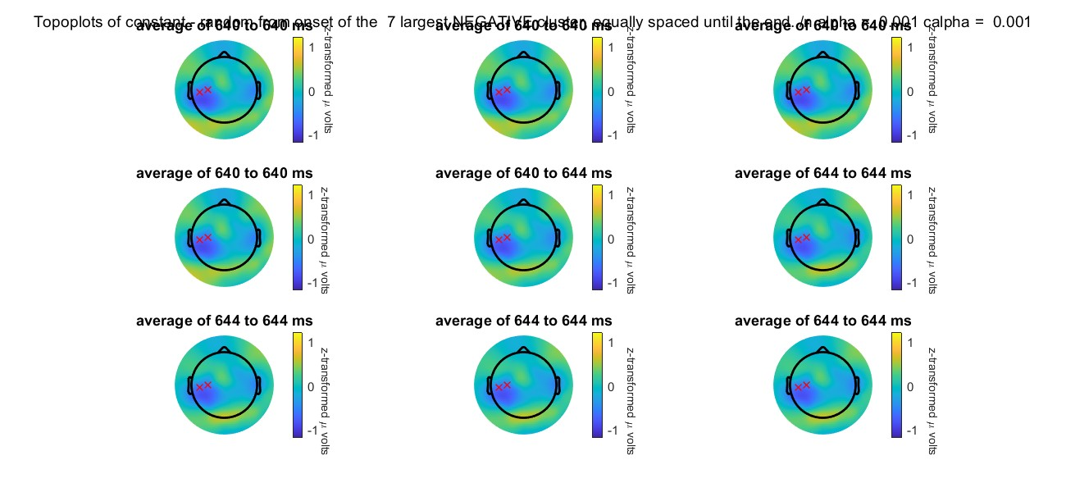
Topoplots Negative

Slide 14
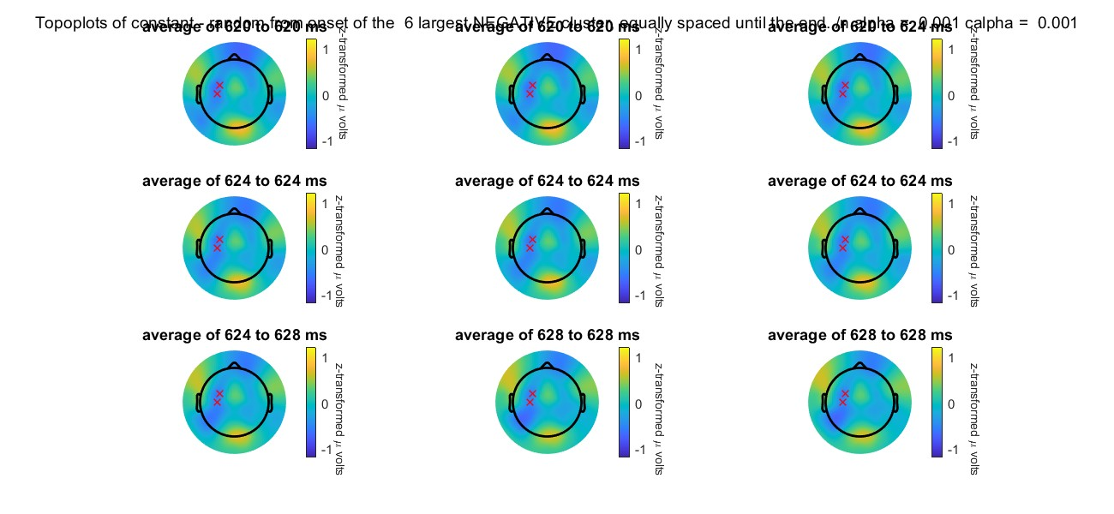
Topoplots Negative

Slide 15
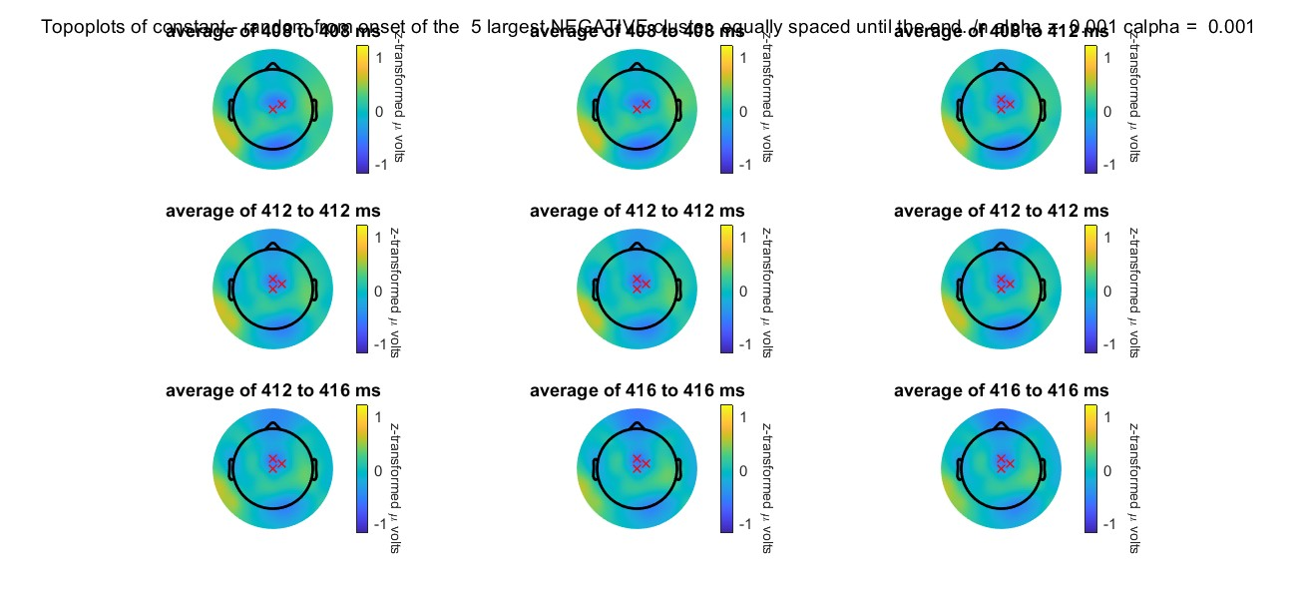
Topoplots Negative

Slide 16
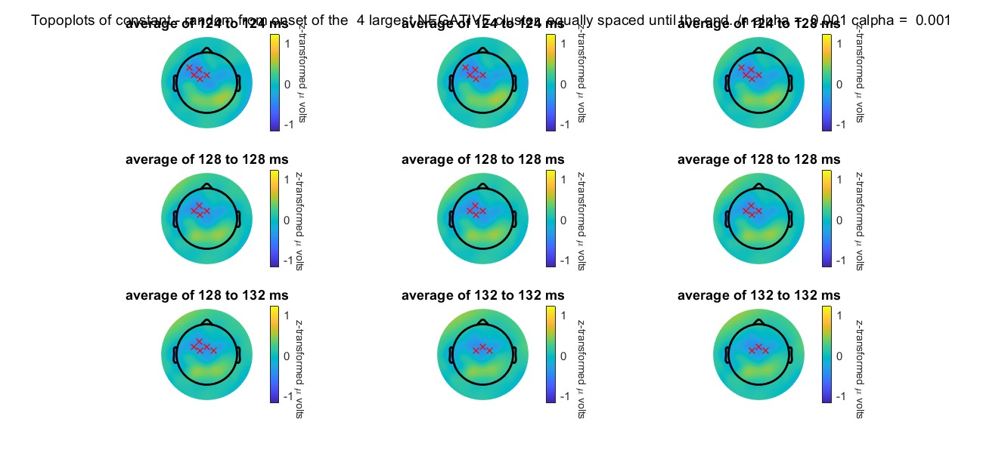
Topoplots Negative

Slide 17
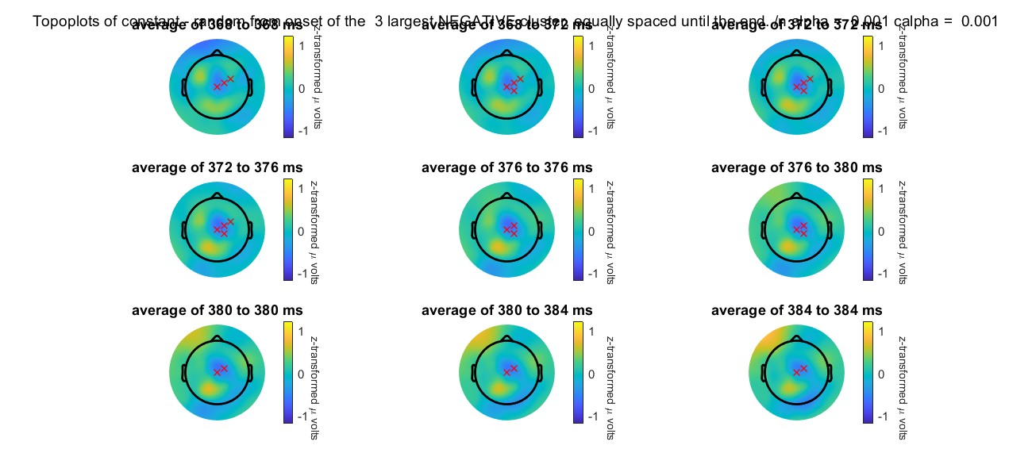
Topoplots Negative

Slide 18
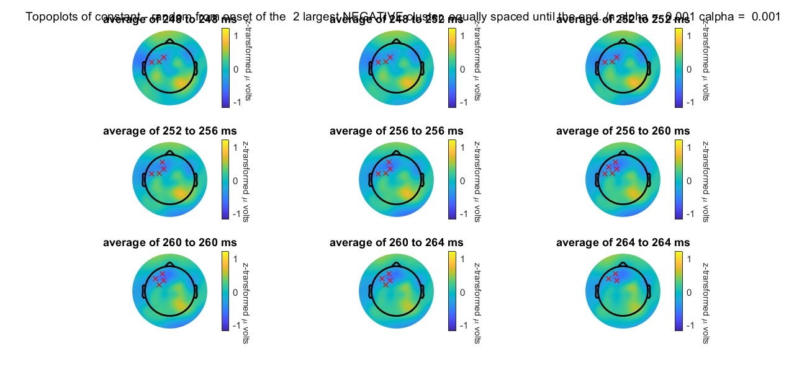
Topoplots Negative

Slide 19
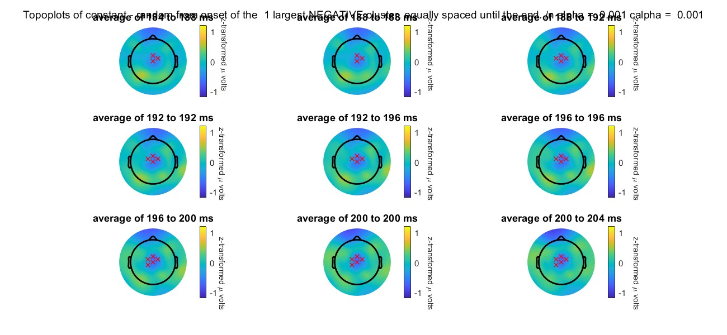
Topoplots Negative: Largest Cluster has 27.41 % of t-Values

Slide 20
My Conclusion: Not sure yet.
Logic for Occluded – Visible doesn‘t work here.

